Slide 6
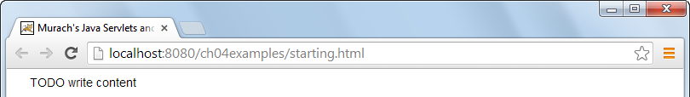

Slide 13
http://www.w3schools.com/html/html5_semantic_elements.asp

Slide 14
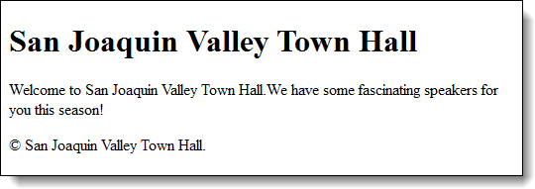

Slide 24


Slide 25
Note: you can pass information via an anchor by encoding the url with get notation:
http://www.site.com?name=john&id=5

Slide 28


Slide 33


Slide 42
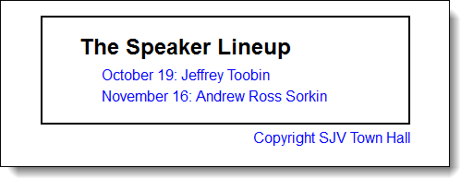

Slide 49

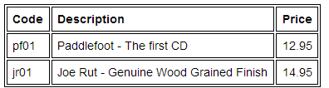

Slide 50


Slide 53

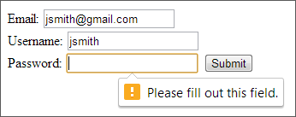

Slide 56


Slide 57


Slide 60
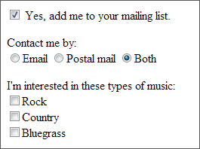

Slide 63
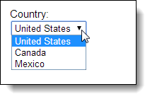

Slide 64
